Slide 1
Physics Jeopardy
Distance and Displacement | Speed and Velocity | Graphing | Acceleration
10 | 10 | 10 | 10
20 | 20 | 20 | 20
30 | 30 | 30 | 30
40 | 40 | 40 | 40
50 | 50 | 50 | 50
60 | 60 | 60 | 60
70 | 70 | 70 | 70
80 | 80 | 80 | 80
90 |  | 90
Final Jeopardy

Slide 2
Identify each of the following quantities as either vector or scalar. A. 5 hours driving in a car B. Swimming for 100 m [N]
Distance vs. Displacement: 10 points
A. Scalar B. Vector

Slide 3
Define distance and displacement.
Distance vs. Displacement: 20 points
Distance describes the length of a path between two points or locations.
Displacement describes the straight-line distance and direction from one point to another.

Slide 4
A house is 350 m [W] of a stop sign and the school is 200 m [E]. What is the distance from the house to the school?
Distance vs. Displacement: 30 points
550 m

Slide 5
If a rolling cart moves with uniform motion at a rate of 2 m/s in the forward direction, what will its displacement be after 5 s?
Distance vs. Displacement: 40 points
10 m [forward]

Slide 6
A person walks 20 m [E] and then walks 35 m [w] what is the person’s total distance and displacement?
Distance vs. Displacement: 50 points
Distance: 55 m
Displacement: 15 m [W]

Slide 7
A driver of a car is travelling at 50km/h sees a deer crossing the road ahead. It takes the driver 1.2 s to react and start to apply the brakes. How far did the car travel before the driver hit the brakes?
Distance vs. Displacement: 60 points
17 m

Slide 8
A cat sitting 6 m [N] of a tree walks to a position 3 m [S] of the tree. What is the displacement of the cat?
Distance vs. Displacement: 70 points
9 m [S]

Slide 9
What is the displacement of a bicycle that travels 28.8 km/h [N] for 15 s? Answer in m/s².
Distance vs. Displacement: 80 points
120 m/s²

Slide 10
Jessica walks 5.5 m [N] and 6.7 m [E] from her house to the gym. What is her displacement to the nearest tenth?
Distance and Displacement: 90 points
8.7 m [NE]

Slide 11
Identify each of the following quantities as either vector or scalar. A. Driving 50 km/h [E] B. Driving 80 km/h
Speed vs. Velocity: 10 points
Vector
Scalar

Slide 12
Define speed and velocity.
Speed vs. Velocity: 20 points
Speed is the distance an object travels during a time interval divided by the time interval.
Velocity is the displacement of an object during a time interval divided by the time interval.

Slide 13
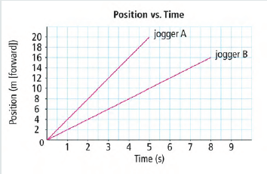
Which jogger was travelling faster?
Speed vs. Velocity: 30 points
Jogger A

Slide 14
A delivery truck travels directly north for 15 min. At the end of the trip the driver notes she has travelled 20 km. What is the average velocity of the truck during the trip?
Speed vs. Velocity: 40 points
80 km/h [N]

Slide 15
A boat travels 280 m [E] in a time of 120 s. What is the boat’s average velocity?
Speed vs. Velocity : 50 points
2.3 m/s [E]

Slide 16
How long would it take a cat walking north at 0.80 m/s to travel 12 m north?
Speed vs. Velocity: 60 points
15 s

Slide 17
At the 2008 Olympic Games in Beijing, Michael Phelps won eight gold medals in swimming. In the 200 m freestyle, Phelps swam with a world record time of 1 min and 42.9 s. What was his winning average speed in m/s?
Speed vs. Velocity: 70 points
1.94 m/s

Slide 18
A Boeing 747 jet has an average cruising velocity of 780 km/h. How long in minutes would it take to fly the 675 km distance from Vancouver to Calgary?
Speed vs. Velocity: 80 points
52 min

Slide 19
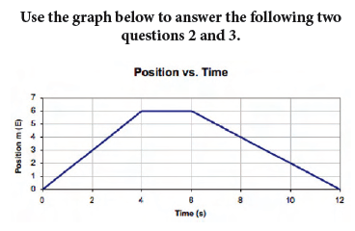
What is the total distance of this object?
Graphing: 10 points
12 m

Slide 20
What does the horizontal section of the graph between time 4 s and 6 s indicate about the object?
Graphing: 20 points
The object is at rest.

Slide 21
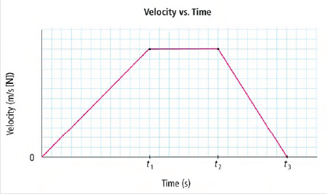
State during what time interval: a. acceleration was zero ____________ b. acceleration was negative ________ c. acceleration was positive ________
Graphing: 30 points
t1 to t2
T2 to t3
0 to t1

Slide 22
If you were to create a position-time graph for someone who is standing still, what kind of slope would the graph have (positive, zero or negative)?
Graphing: 40 points
Zero slope

Slide 23
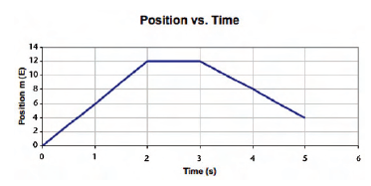
What is the total displacement of the object based on the graph above?
Graphing: 50 points
4 m [E]

Slide 24
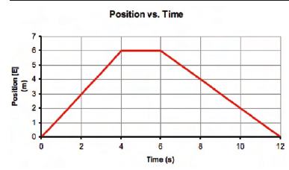
The graph below shows the motion of an object. What is the average velocity of the object between 6.0 s and 10 s?
Graphing: 60 points
1.0 m/s [W]

Slide 25
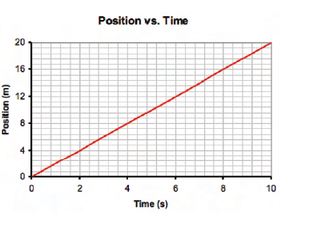
What is the average velocity represented by the graph above?
Graphing: 70 points
2 m/s

Slide 26
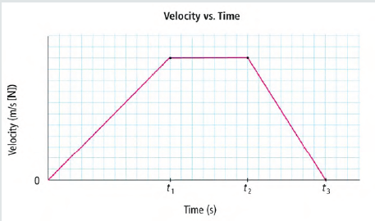
State on which time interval the acceleration is positive.
Graphing: 80 points
0 to t₁

Slide 27
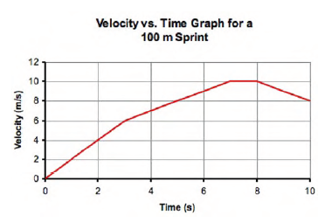
The graph above shows the motion of a sprinter during a 100 m sprint. Where does the sprinter have the greatest acceleration?
Graphing: 90 points
O to 30 s

Slide 28
What is acceleration?
Acceleration: 10 points
Is the rate of change in velocity

Slide 29
If a car is accelerating at –5.0 km/h, is it going backward or slowing down?
Acceleration : 20 points
The car is slowing down, not possible to know if it is going forward or backward form the info given

Slide 30
While a car is backing up, its velocity changes from −3 m/s to −9 m/s. What would be its total change in velocity?
Acceleration: 30 points
− 6.0 m/s

Slide 31
A rock is thrown up into the air and allowed to fall. If up is the positive direction, what kind of acceleration does the rock experience?
Acceleration: 40 points
negative acceleration
The effects of gravity
are acting against the positive direction of
motion (up).

Slide 32
How much time does it take a car travelling south at 12 m/s to increase its velocity to 26 m/s south if it accelerates at 3.5 m/s2 south?
Acceleration: 50 points
4 s

Slide 33
A toboggan moving 5.0 m/s forward decelerates at −0.40 m/s² for 10 s. What is the toboggan’s velocity at the end of the 10 s?
Acceleration: 60 points
1 m/s forward

Slide 34
Mary accelerates her car from 80 km/h [E] to 100 km/h [E] in 5.0 s. What is her acceleration in m/s2?
Acceleration: 70 points
1.2 m/s2

Slide 35
A ball is thrown upward from the top of a tall building at an initial vertical speed of 50.4 km/h. The acceleration of gravity on the ball is 9.8 m/s2 down. What is the velocity of the ball 2.50s later?
Acceleration: 80 points
38.5 m/s

Slide 36
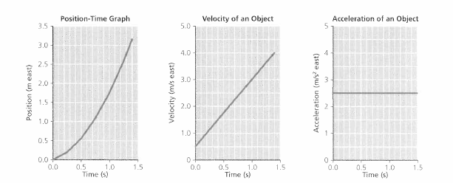
Final Jeopardy
What type of motion are each of the graphs below showing?
an object speeding up (accelerating) to the east

